Slide 1
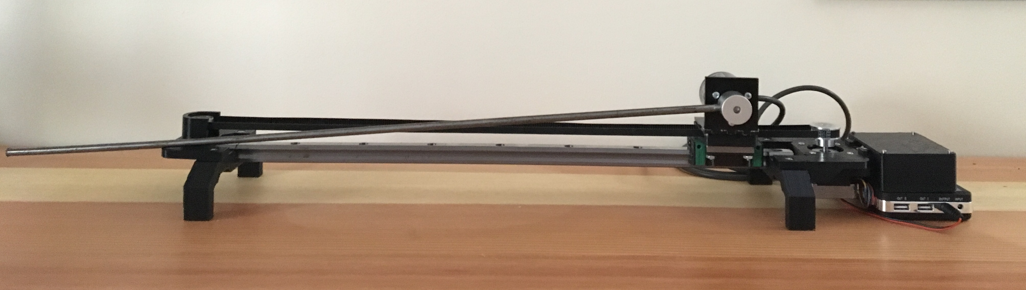
Figure 1. Inverted Pendulum Assembly
Bipolar Stepper Motor
Radial Ball Bearing
Timing Pulley
Controller Module
Ball Bearing Carriage
Steel Rod Pendulum
Timing Belt
Rotary Encoder
Battery
Slide Rail

Slide 2
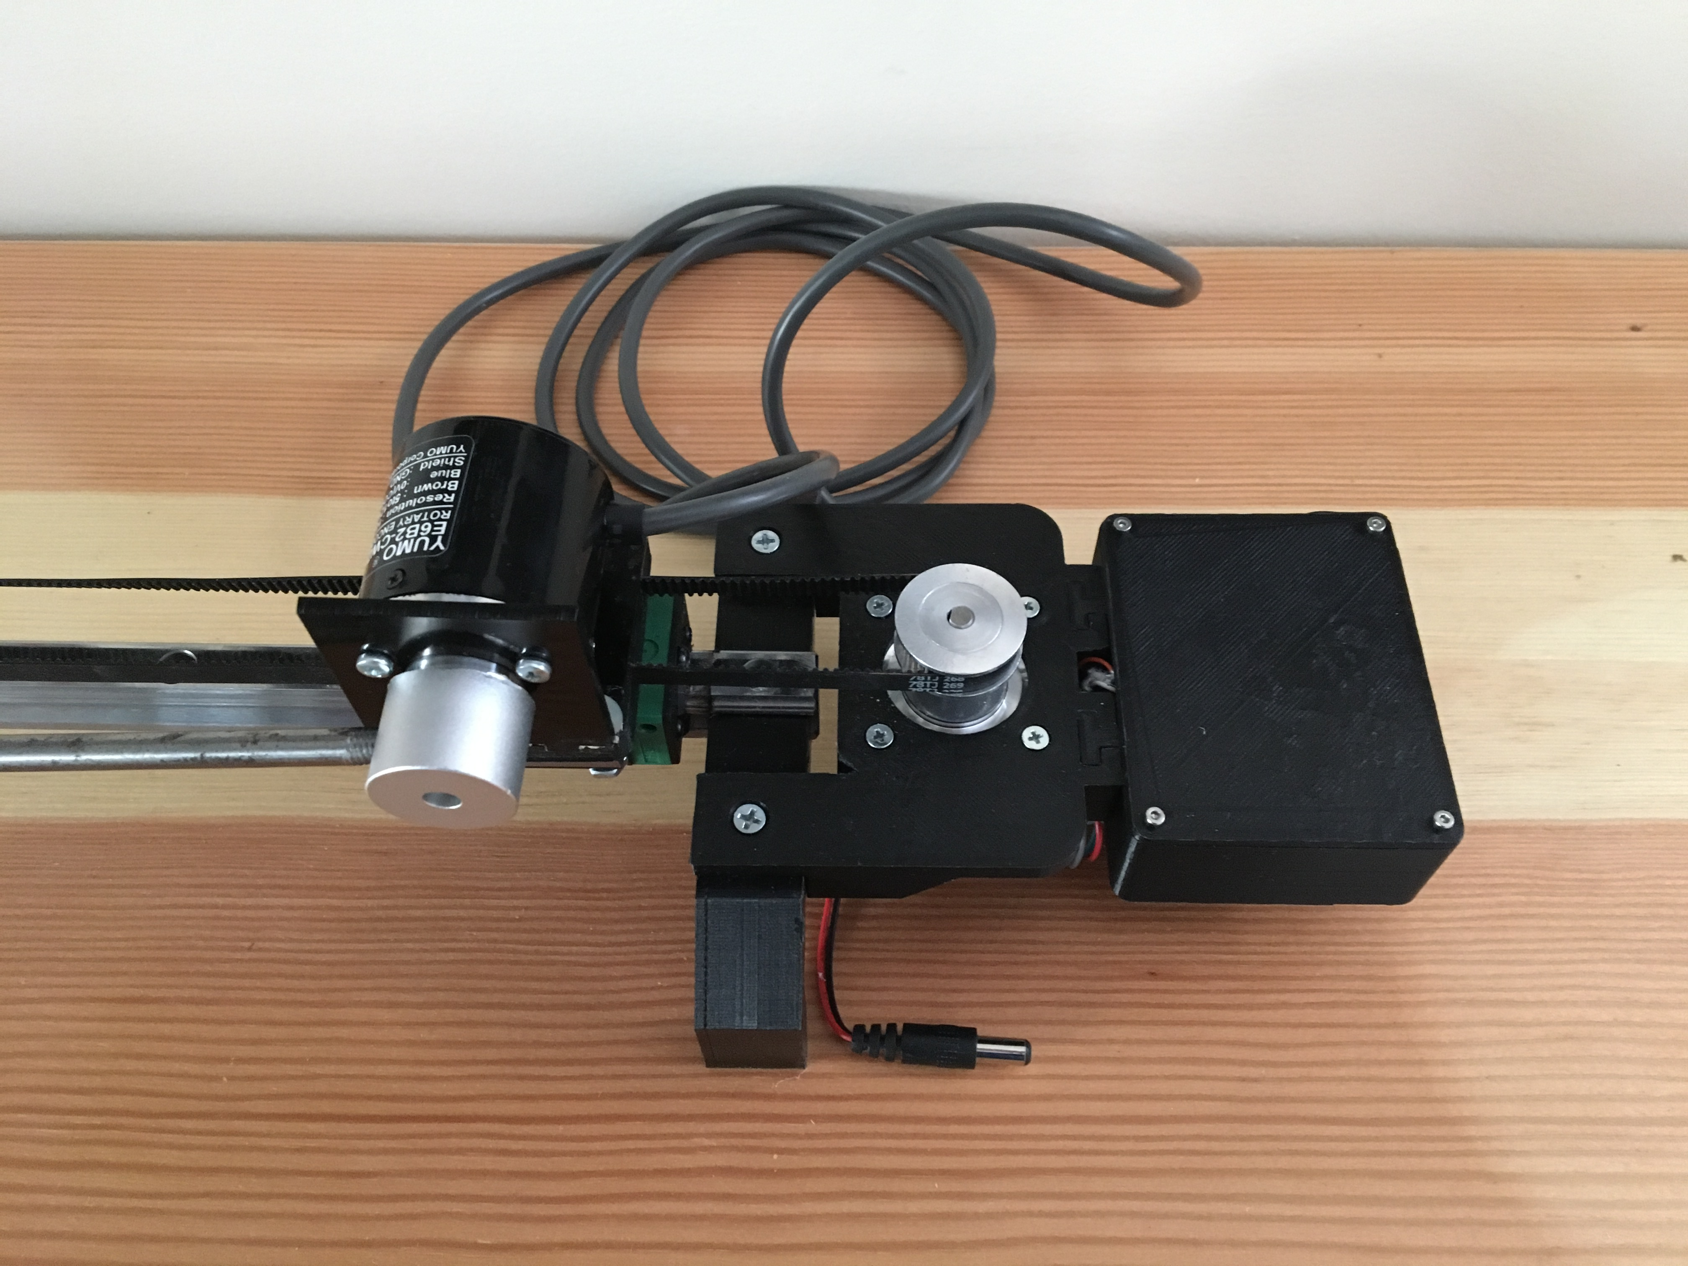
Figure 2. Detailed View of Encoder and Motor Assemblies
Timing Belt
Timing Pulley
Controller Module
(3D Printed)
Steel Rod Pendulum
Motor Mount
(3D Printed)
Rotary Encoder Hub
Bipolar Stepper Motor
Rotary Encoder Mount
(3D Printed & Laser Cut)
Rail Foot
(3D Printed)
Battery Connection

Slide 3
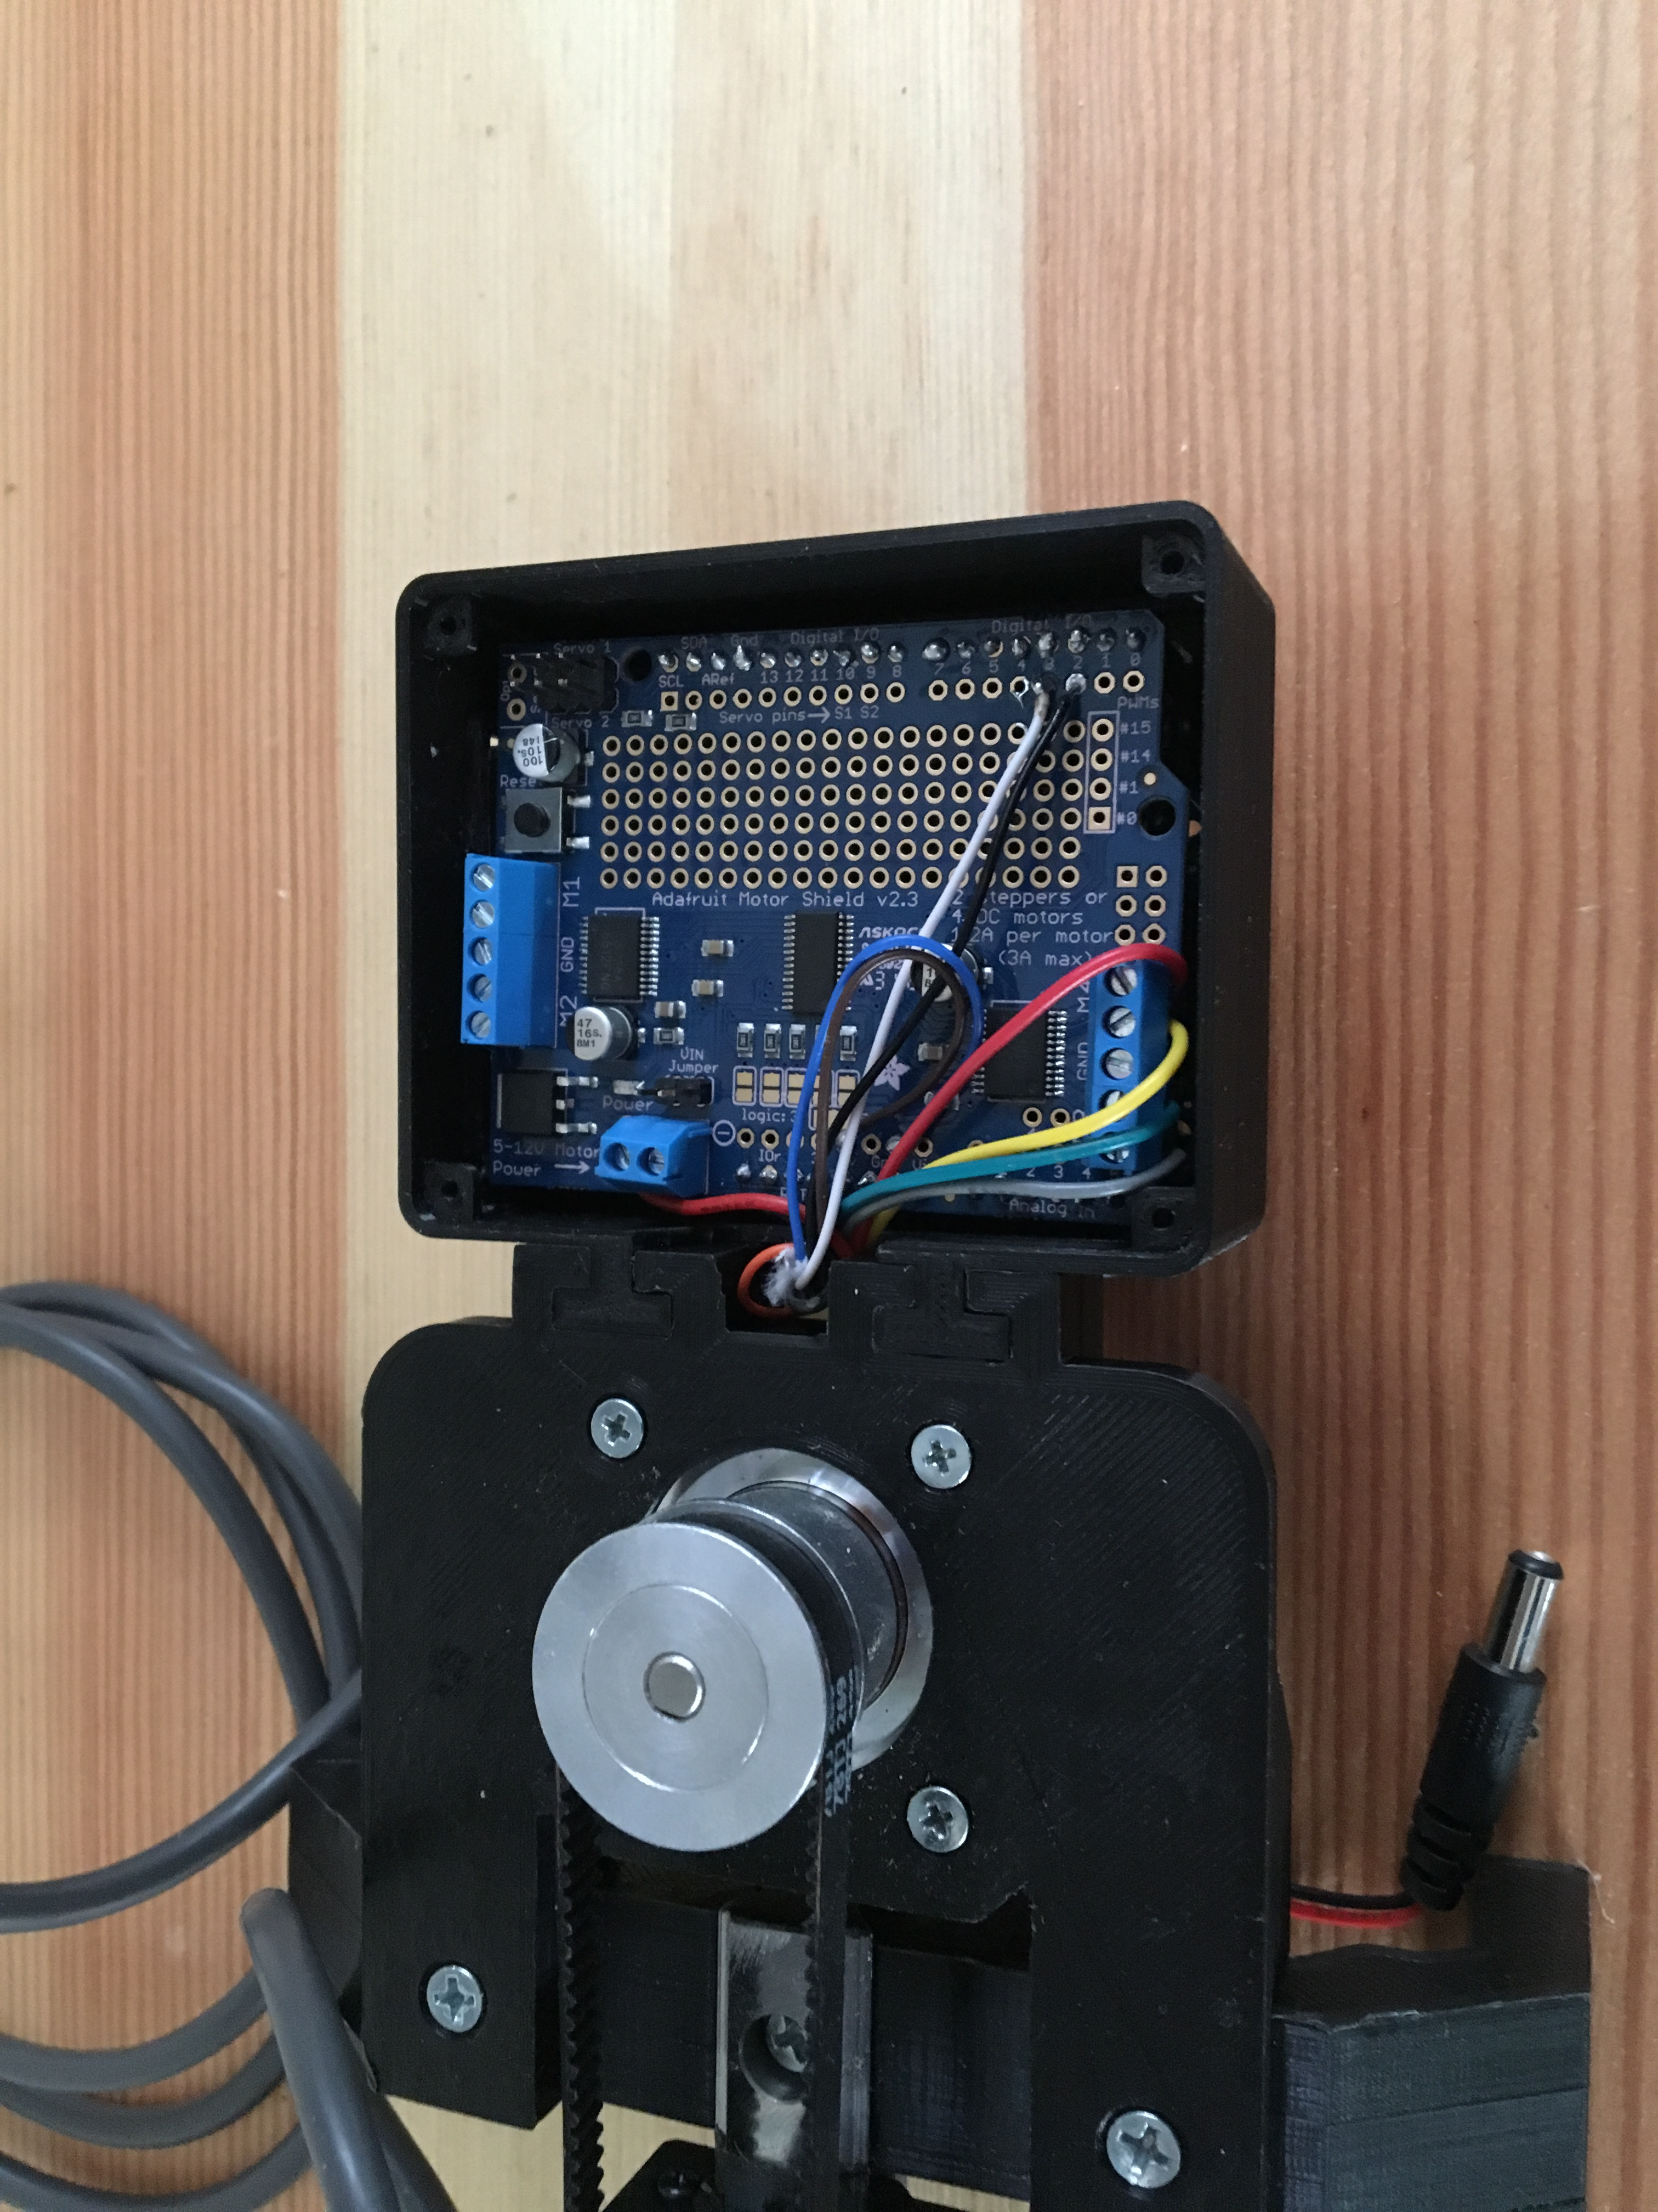
Figure 3. Detailed View of Controller Module
Battery Ports
Adafruit Stepper Shield for Arduino
Rotary Encoder External Interrupt connection
Bipolar Stepper Motor Connection
Arduino Uno

Slide 4
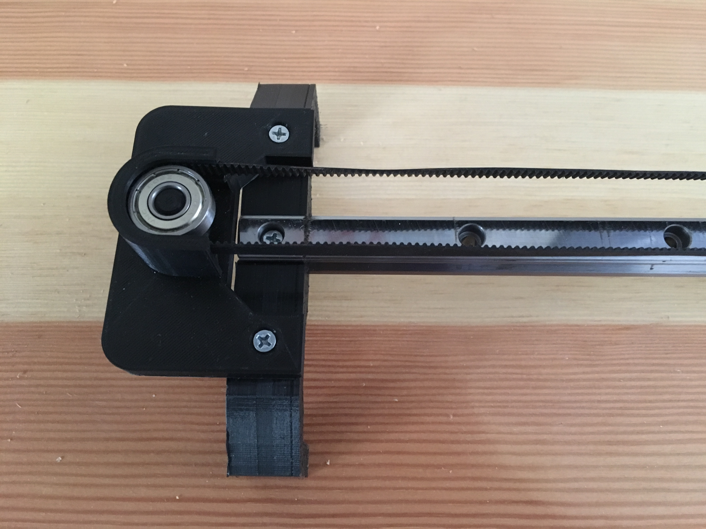
Figure 4. Detailed View of Ball Bearing Mount
Timing Belt
Radial Ball Bearing
Ball Bearing Mount
(3D Printed)
Slide Rail
Rail Foot
(3D Printed)

